Slide 1
Design Exercise
The Grommet

Slide 2
UX Designer
Prototype | Usability Evaluation
Rocket Software, Inc.
CloudLeap Tech – Intern
SparkSoft Corp – Intern
Accenture
Boot-camp
SQL DBA & BI
MS Human Centered Computing
B. Tech. Computer Sciences

Slide 3
Process
Ideal vs Current

Slide 4
Ideal vs Current

Slide 5
Info gathering
Competitive Analysis
Stakeholder
Interview
Persona
Design
Thinking
Prototype
Test
Wireframes
- Info gathering
- Stakeholder Interview
- Competitive Analysis
- User Interview
- Heuristic Eva
Design Thinking
White Boarding
Lo-Fi
Prototype
Hi-Fi
Prototype
Test
n
n
2
Ideally
This Case

Slide 6
Information Gathering
Done via
going through problem desc.
Questions to stake holder (Vanessa)

Slide 7
Infor Gathering
What, How, Who & Why
Mission
Problem and Objectives
Maker’s story accessible and prevalent
Improve exploration and product purchase
Competitive analysis and UX modernization
Conversion – buying products
User’s expectation of e-commerce platform
While telling maker’s story
Balance
Notes:
Maker’s story – layout ;
Exploration and product conversion – easy of user and touching the point points
Competitive Analysis -

Slide 8
Info Gathering
Because : we have a unique way of doing things
Story & E-commerce
Challenge : (not so unique)
Everyone does it, marketing helps them; we need to do it via telling maker’s story
Re-imagine : (initial thoughts)
Both the experience blending together perfectly

Slide 9
Understanding the product
Done via
Interviewing users : contextual inquiry
First glance at sight & Heuristic Evaluation :
performing a simple user story

Slide 10
First Glance & Heuristic Evaluation
Home Page
Product Page
Details
Cart
Check-out
Consistency
Clarity of info.
Layout
Feedback
Interactions
Control
Ease of access
Buying Process

Slide 11
HOME PAGE
Some tiles/options from home page take me to maker- page while others take me to product page
Consistency

Slide 12
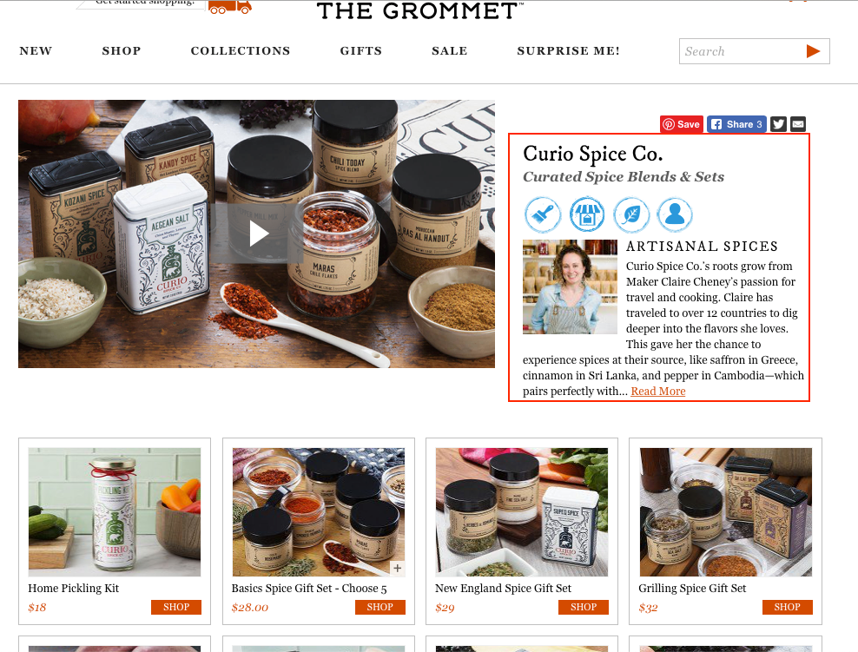
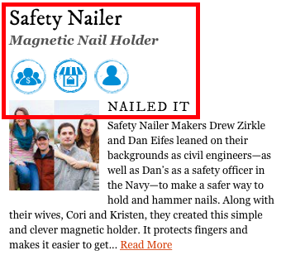
Product Vs Maker Vs Brand Name
Confusing to figure out where we are : maker vs product
Too busy, too much information
Clarity
Notes:
For the first time user, it gets difficult to to figure out….

Slide 13
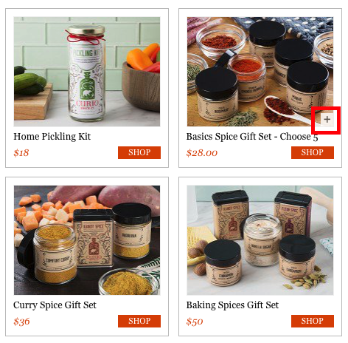
‘ + ’ on product card
First time user doesn’t know what ‘+’ does.
Could be add to cart
Could be more details
Could be customizable product
Consistency

Slide 14
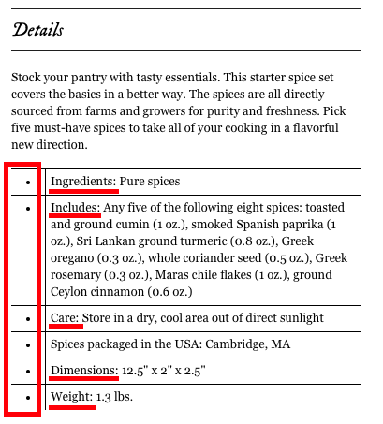
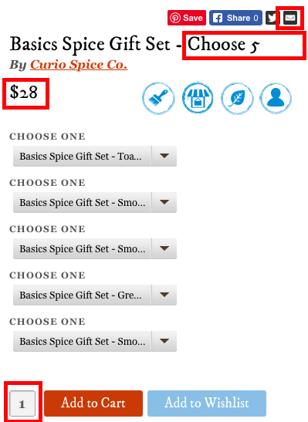
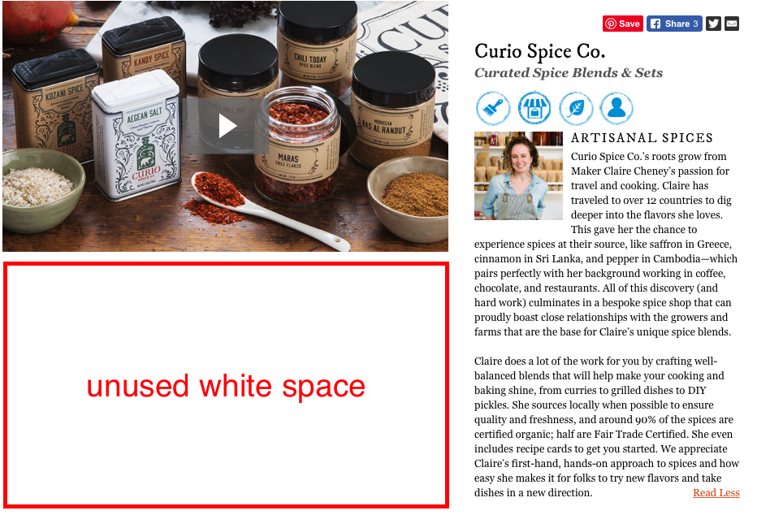
Product Description
White space
Change on expand
Bottom of the page
Improvements at description
typography
Specifications
Layout
Modernization
Ease of viewing

Slide 15
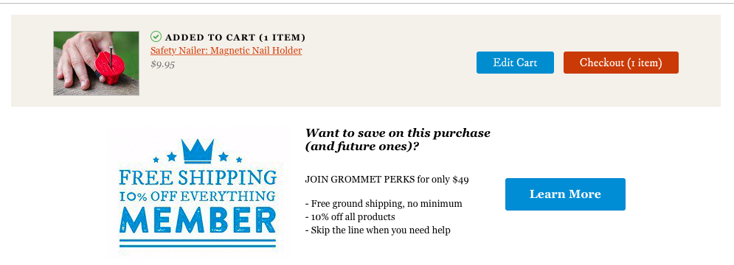
Cart Transition
Moves another page
Multiple ways execute same task
No Cart Preview / take to another page
Continue shopping?
Qnty picker
Doesn’t retain user’s info
Interaction
Confusing
Ease of use
Minimal

Slide 16
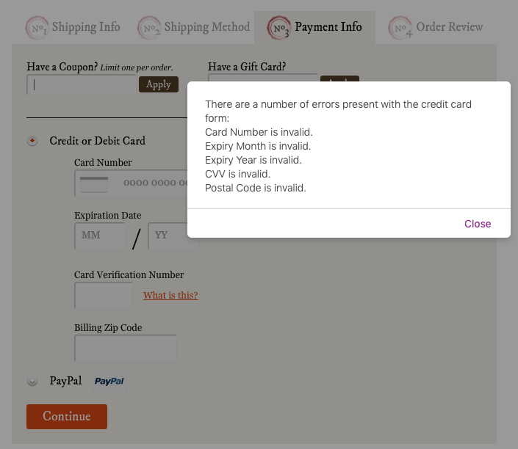
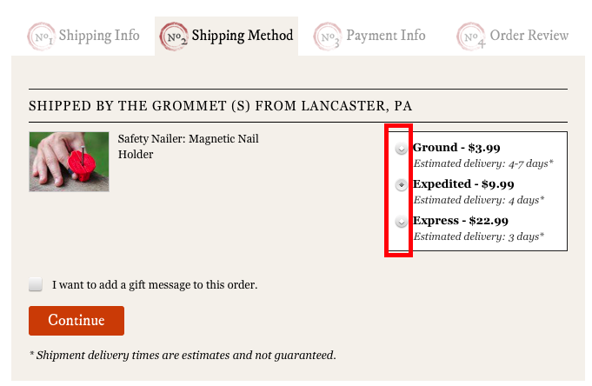
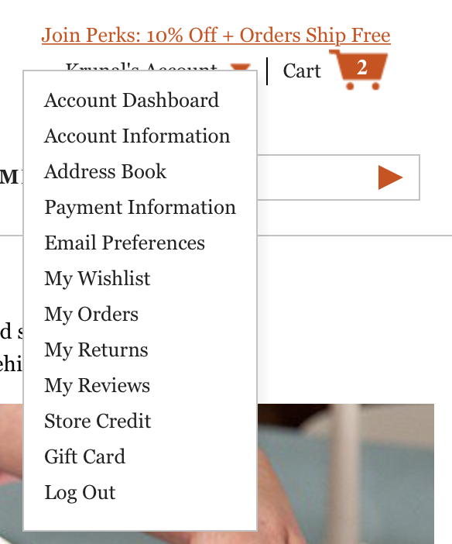
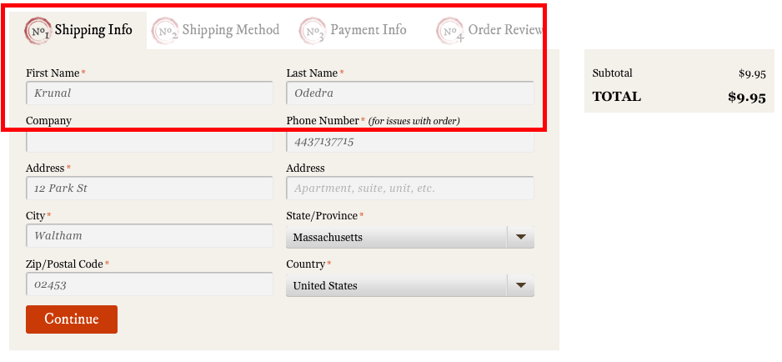
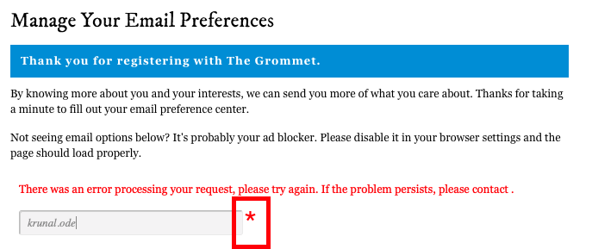
Checkout as guest
Register via email – missing.
Autofill
Selected Radio Buttons
Error handling
Ease of use
Feedback
Recognition over recall
Notes:
1. when I am in guest mode

Slide 17
Competitive Analysis
Amazon
Kickstarter
Touch of Modern
Notes:
Before we re-invent the wheel, best way to begin a solution is to see what other have accomplished and working for them

Slide 18
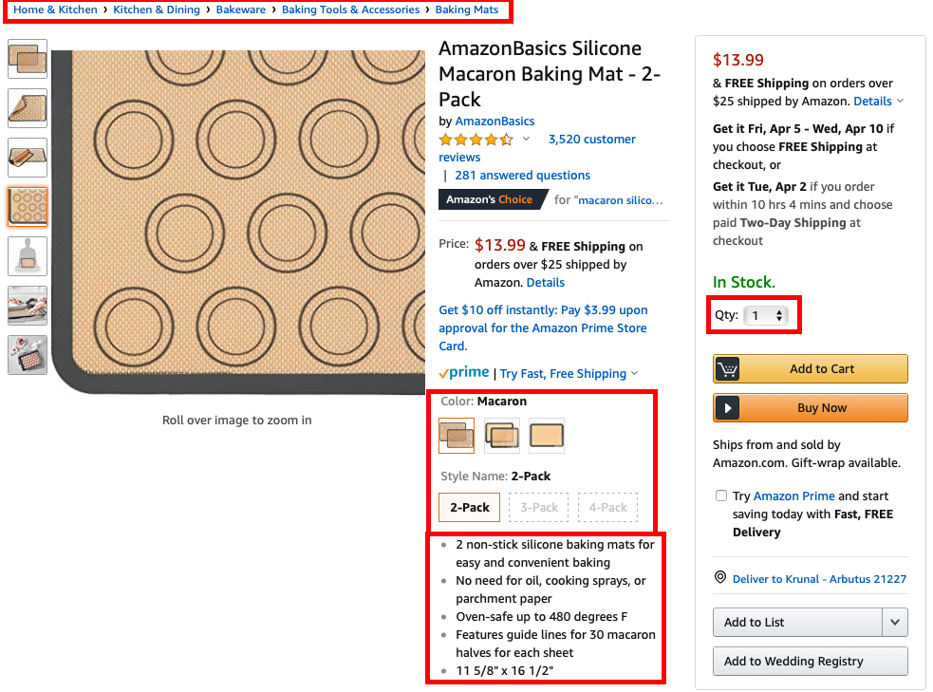
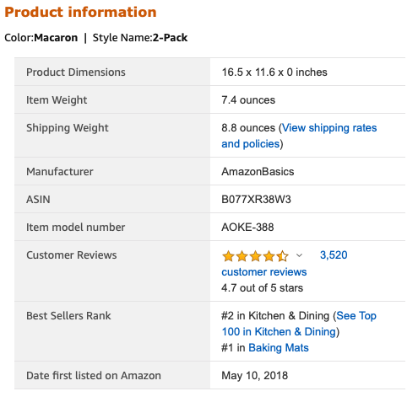
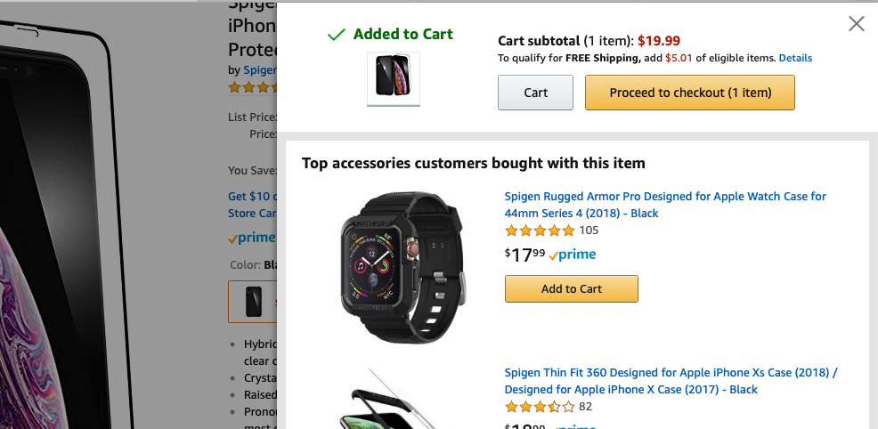
Amazon
Good description layout
Everything a buyer needs to know, right there
Vertical Carousel
Pan zoom
Drop-down for quantity
Color & Size preview
Detailed description - below
Spec – categorized and simplified
Cart – fly-in success notification

Slide 19
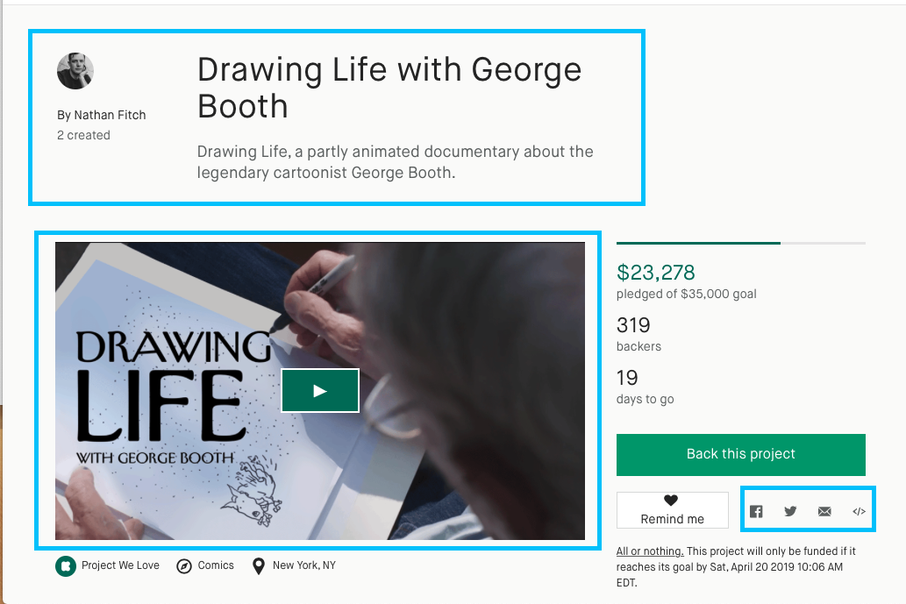
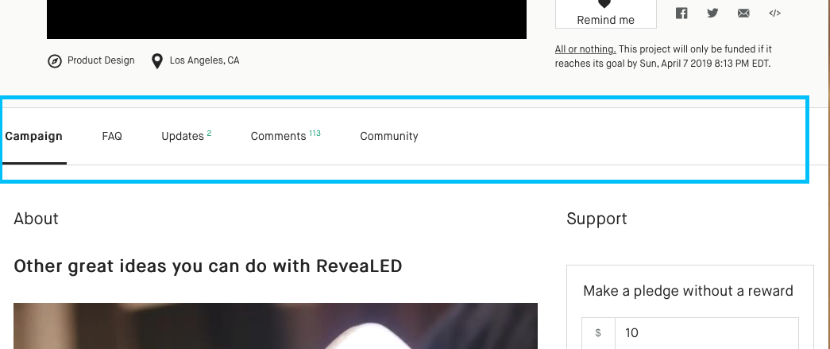
Kickstarter
Small intro of maker and product
Cleaner share links
Smart intro video ( intro + story + features)
A tab-switcher for rest of the content
Solves a problem of multiple pages

Slide 20
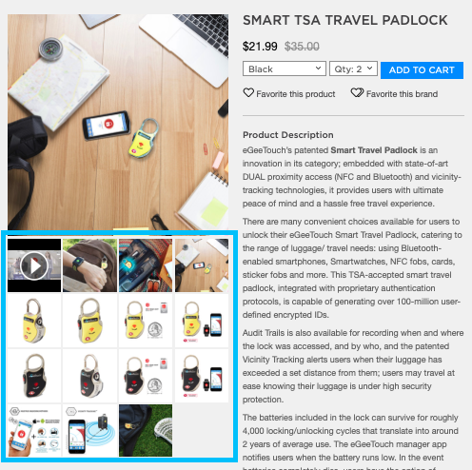
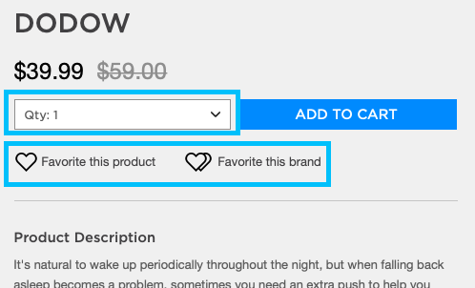
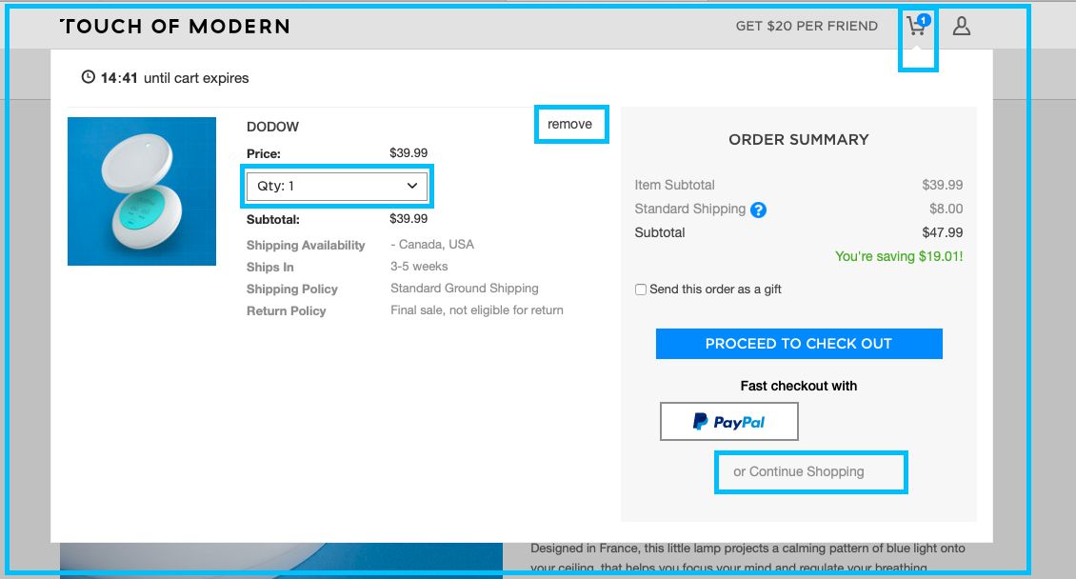
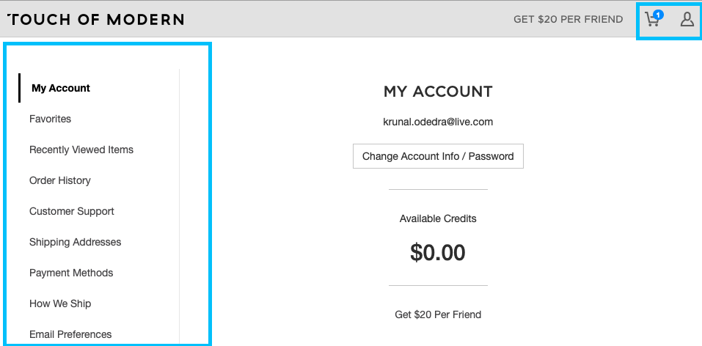
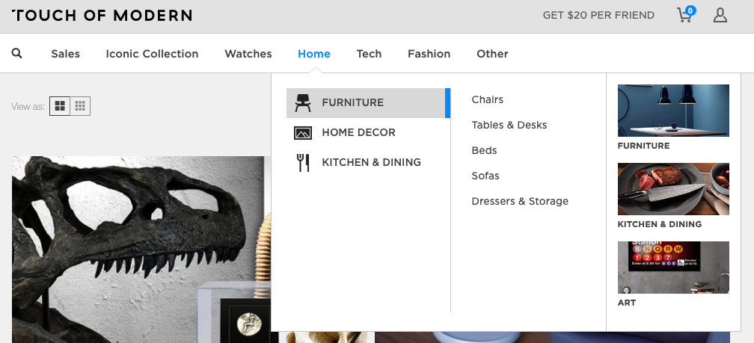
Touch of Modern
Categorized menu structure
Qnty & ‘fav maker’
Cart : fly-in
Carousel vs visibility
Modern Design

Slide 21
User Interviews
Susheel T.
Principal Architect
Health IT
Waltham, MA
Hoshang M.
Data Analyst
B2B Product Sales
Somerville, MA
Nitika K.
Java Dev
Financial services
Baltimore, MD
Contextual Inquiry
Handouts: Please refer page 2 for details
Notes:
Leader – Apprentice model,

Slide 22
Findings
Pain-points
Suggestions
Likes
Handouts: Please refer section 3 for details
Notes:
There are more finding and suggestion then like, because of the way interview was structured

Slide 23
Persona
Done via
3 persona

Slide 24
Persona
Jessica Johnson
Architect
25-35
Creative, Perfectionist
Bob Bishop
Retired Banker
50-60
Organized, DIY, Wealthy
Debbie Dowson
Yoga Tutor
20-25
Calm, Online Shopper
Demo
Handouts: Please refer section 4 for details
Notes:
Leader – Apprentice model,

Slide 25
Whiteboarding
Done via
Pen & Paper
Crazy 8/2
5 Layouts

Slide 26
Layouts
5 Layouts
Single solution
Demo
Pen & Paper
Handouts: Please refer section 5 for details
Notes:
Leader – Apprentice model,

Slide 27
Prototype
Done via
Lo/Mid-Fi
Notes:
Deliberately : Quick-dirty, Sketch-like and Grey-scale.

Slide 28
Lo/Mid-Fi
5 Quick & Dirty
Grey-scale
Best of the layouts
Demo
Notes:
Leader – Apprentice model,

Slide 29
Thanks

